Slide 1
Integrating Azure Data Factory and Azure Data Lake Storage
Madiha Aimon

Slide 2
Introduction
This project aims to establish a data pipeline using Azure Data Factory (ADF) to transfer data between various folders within an Azure Data Lake Storage (ADLS) account.

Slide 3
Project Overview
Establish secure connections between ADF and ADLS using linked services.
Design an ADF pipeline with a "Copy Data" activity to move data from a source folder to a destination folder in ADLS.
Configure the pipeline to specify the source and destination datasets, file format, and any additional settings like compression or partitioning (if needed).
Schedule the pipeline for regular execution to automate data movement.
Monitor pipeline runs to ensure successful completion and identify any potential errors.

Slide 4
Project Flow
Project Setup:
Azure Resources: Create an Azure Data Factory (ADF) and an Azure Data Lake Storage Gen2 (ADLS Gen2) account within your Azure subscription.
Linked Services: Establish secure connections between ADF and ADLS Gen2 using linked services, specifying authentication details.
Environment:
Development Environment: Use the Azure Portal to manage resources and the ADF to design the data pipeline.

Slide 5
Project Goal
Automate data movement between different folders within an Azure Data Lake Storage (ADLS) account using Azure Data Factory (ADF).

Slide 6
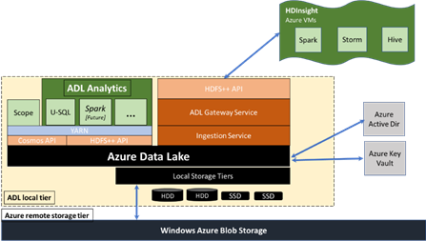
Architecture diagram

Slide 7
Overview of Azure Data factory(ADF)
1.Data Integration:
ADF enables the creation, scheduling, and orchestration of data pipelines for seamless movement and transformation of data across diverse sources and destinations.
2.Hybrid Data Movement:
It facilitates integration between on-premises and cloud data sources without complex networking configurations, ensuring smooth data movement.
3.ETL and ELT:
ADF supports both ETL and ELT patterns, enabling scalable data transformation using serverless compute resources like Azure Databricks or HDInsight.
4.Integration with Azure Services:
Native integration with various Azure services such as Azure Synapse Analytics and Azure Data Lake Storage expands its capabilities for comprehensive data integration and analytics.

Slide 8
Overview of Azure Data Lake Storage (ADLS)
1.Scalable Storage:
ADLS provides a highly scalable and cost-effective storage solution capable
of handling massive amounts of data.
2.Hierarchical Namespace:
It offers a hierarchical namespace structure for organizing data into folders
and subfolders, enabling efficient data management and navigation.
3.Integration with Analytics Services:
ADLS seamlessly integrates with various analytics services such as Azure
Data Factory and Azure Synapse Analytics for processing and analyzing
large datasets.
4.Security and Compliance:
Robust security features, including Azure Active Directory integration and
granular access controls, ensure data security and
compliance with regulatory requirements.

Slide 9
Azure Resources Used
1. Azure Data Factory (ADF):
ADF Workspace: A cloud-based environment within Azure to
develop, manage, and orchestrate data pipelines.
2. Azure Data Lake Storage (ADLS):
ADLS Account: A managed storage service in Azure for storing
large datasets in a highly scalable and secure manner.
3. Azure Blob Storage
Blob Storage Container: A container within an Azure Blob
Storage account that serves as a repository for object data.

Slide 10
Project Requirements
This project outlines the requirements for developing three data
pipelines using Azure Data Factory (ADF)
1. Functional Requirements:
Data Transfer: The pipelines must successfully transfer data
between the specified source and destination .
File Format Handling: The pipelines must be able to handle the
chosen file formats
2. Non-Functional Requirements:
Scalability: The pipelines should be able to handle large datasets
efficiently and scale to meet future data processing needs.
Security: The project should implement security best practices,
such as using Azure Key Vault to store access keys securely and
avoiding hardcoding them in the pipelines.

Slide 11
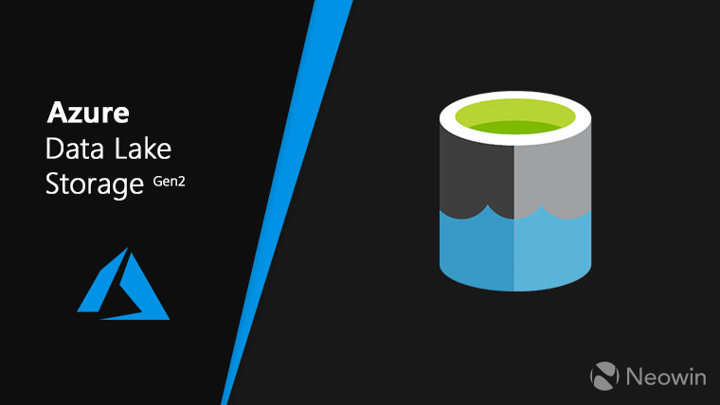
Implementation of the project

Slide 12
Types of Copy Activities to automate data movement.
Data Lake Storage Gen2 to Data Lake Storage Gen2 Copy Activity:
Data Lake Store to Azure Data Lake Storage Gen2 Copy Activity:
Azure Blob Storage to Data Lake Storage Gen2 Copy Activity:

Slide 13
Creating Linked Services
1.Linked Services:
Establish connections between ADF and data stores
Define authentication and authorization details
2.Steps to Create Linked Services:
Navigate to "Manage" and select "Linked services" in ADF.
Click "New" and choose "Azure Data Lake Storage Gen2" (or the appropriate version).
Provide connection details, including account name, subscription ID, and access key.
Test the connection to ensure success.

Slide 14
Designing the Pipeline
1.Pipeline Components:
Activities: Define actions (e.g., copying data)
Datasets: Represent data sources and destinations
Parameters: Provide dynamic values for configuration
2.Steps to Design the Pipeline:
Create a new pipeline in ADF.
Drag and drop a "Copy Data" activity.
Configure the activity:
Source dataset: ADLS folder with data to move
Destination dataset: Target ADLS folder
File format: Select the appropriate format (e.g., CSV, Parquet)
Additional settings: Compression, partitioning (if needed)

Slide 15
Technologies used
1.Azure Data Factory (ADF):
Cloud-based service for orchestrating data movement and transformation.
2. Azure Data Lake Storage (ADLS):
Managed storage service for storing large datasets in a scalable and secure manner.

Slide 16
Conclusion
Integrating ADF and ADLS simplifies data management
Automates data movement, improves efficiency
Provides a scalable and secure solution

Slide 17
Reference link
https://learn.microsoft.com/en-us/azure/storage/blobs/data-lake-storage-introduction
https://learn.microsoft.com/en-us/azure/data-factory/load-azure-data-lake-storage-gen2

